Slide 1
Mobile Chess
Sprint 2 – Fall 2014
Aaron Costner Stewart Taylor
Jacob Neal Lewis Sanchez

Slide 2
Overview of Presentation (1/2)
Product Backlog Items Worked On
Use Cases
Sequence Diagrams
Class Diagrams

Slide 3
Overview of Presentation (2/2)
Q&A
Demonstration of Application
Plans For Next Sprint

Slide 4
Product Backlog Items Worked On
Connect User to Login System
This involves the registration and login of users.
Hello World! Application
An application made to test our code written this sprint, and practice deployment to mobile devices (mainly Android for now).

Slide 5
Use Cases

Slide 6
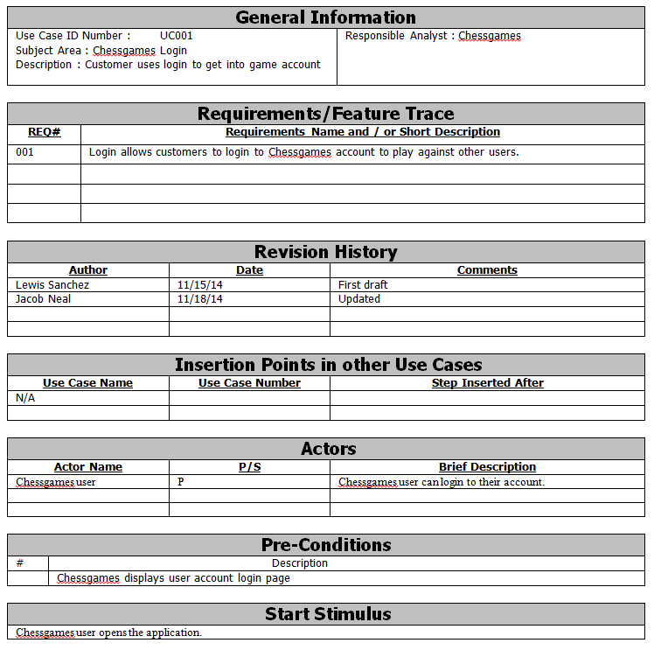

Slide 7
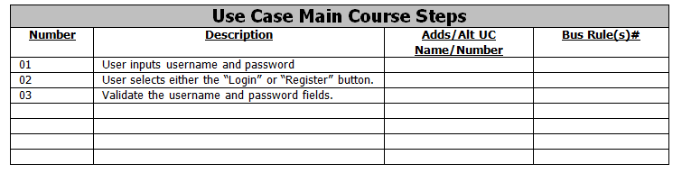
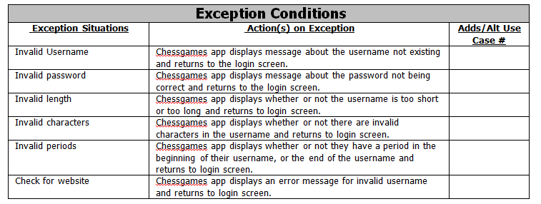

Slide 8
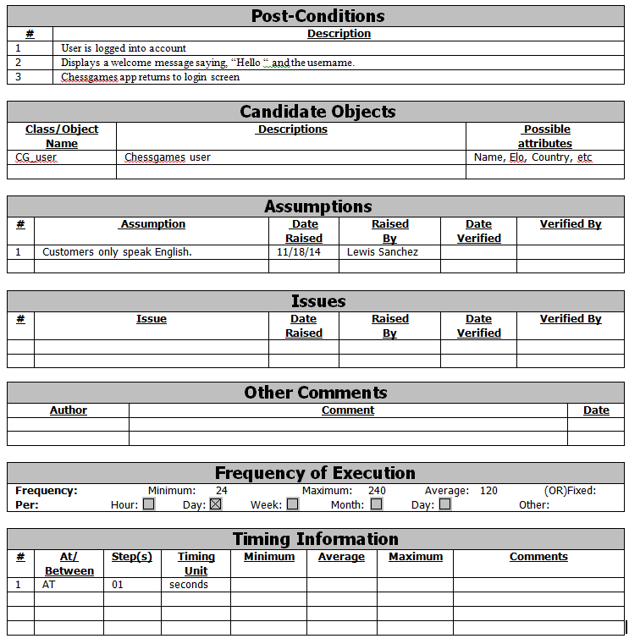

Slide 9
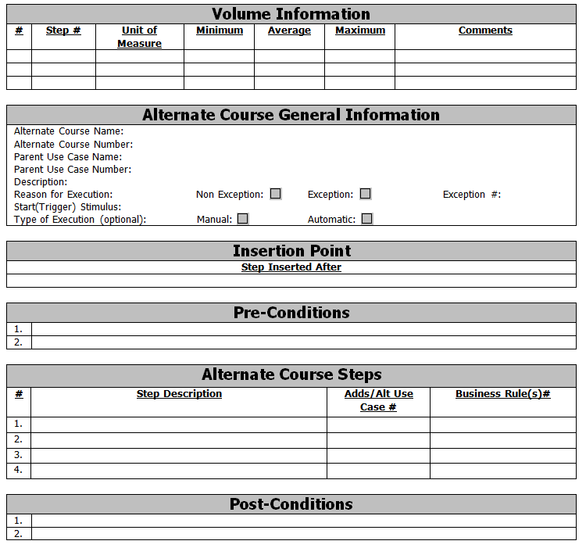

Slide 10
Sequence Diagrams

Slide 11
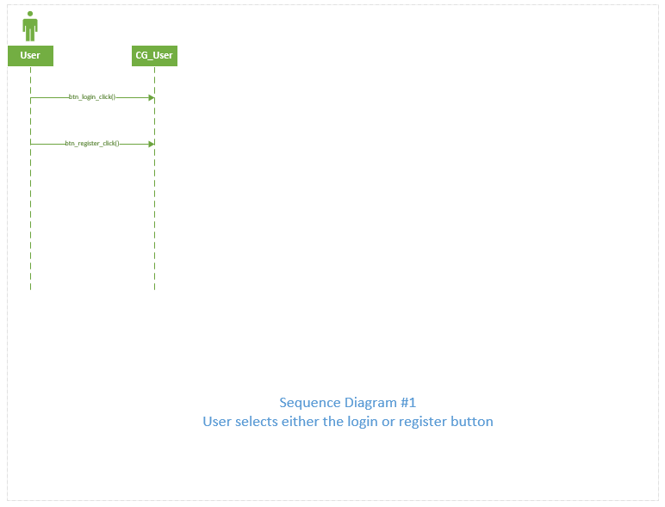

Slide 12
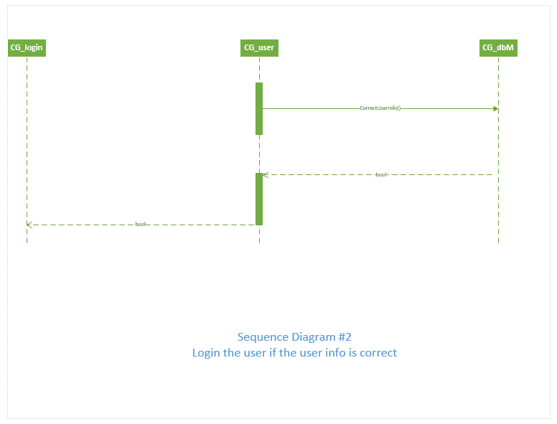

Slide 13
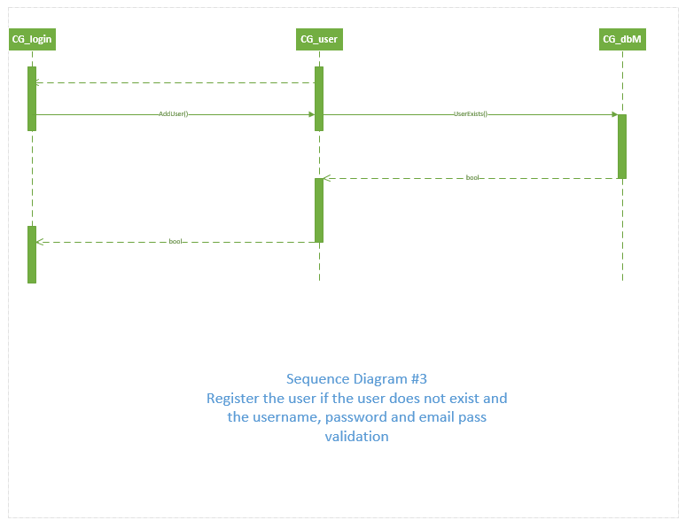

Slide 14
Class Diagrams

Slide 15
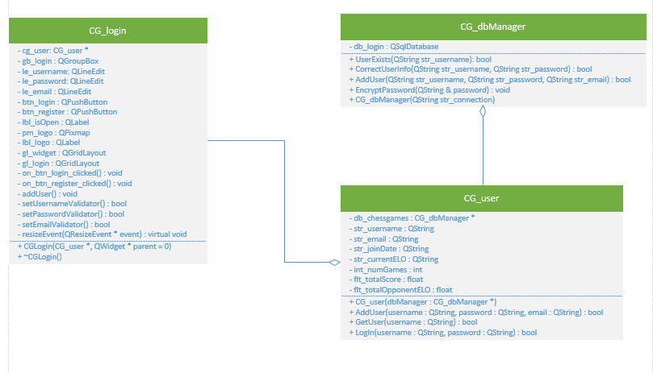

Slide 16
Demonstration of Application

Slide 17
Plans For Next Sprint

Slide 18
Plans for next sprint
Developing the necessary components to network users of the application to play a game of chess.
Implementing game pools, which are essentially queues for specific types of chess games. The pools we will include are 1 minute games, 5 minute games, and 30 minute games.

Slide 19
Q&A

Slide 20
Thank you for your time!

